Slide 1
Principles of Data Science
Li Niu

Slide 2




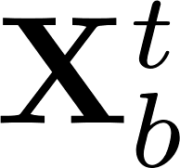

Single-view learning
Multi-view learning
Training feature
Training feature
….
Testing feature
Testing feature
….

Slide 3
Learning using Privileged Information
privileged information
Training feature
….
Testing feature

Slide 4


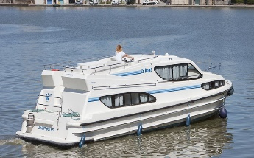
Learning using Privileged Information
Training:
Luxury Yacht at the Miami International Boat Show 2012. Benetti Yachts sees 20% gain in new luxury yacht sales.
visual feature
textual feature
privileged information
Testing:
visual feature

Slide 5
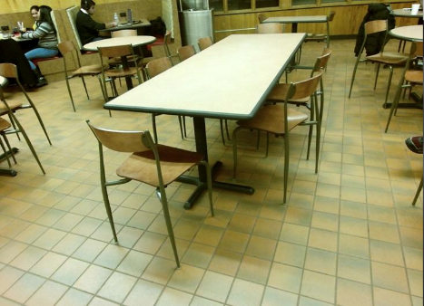
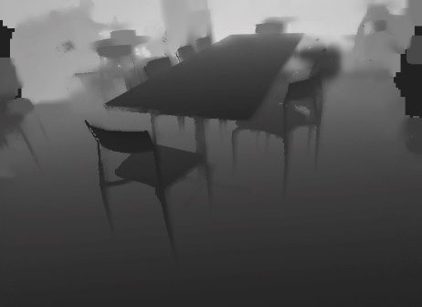
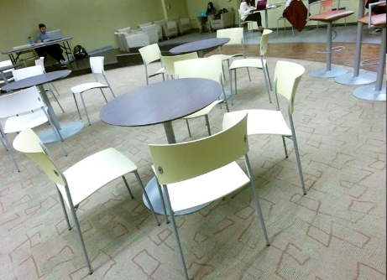
Learning using Privileged Information
Training:
visual feature
depth feature
privileged information
Testing:
visual feature

Slide 6



Learning using Privileged Information
Example 1: Suppose that our goal is to find a rule that predicts the outcome of a surgery in three weeks after it, based on information available before the surgery.
For previous patients, there is also additional information about procedures and complications during surgery, development of symptoms in one or two weeks after surgery, and so on.

Slide 7
Learning using Privileged Information
Example 2: Let our goal be to find a rule to classify biopsy images into two categories : cancer and non-cancer.
The standard diagnostic procedure also includes a pathologist’s report that describes his/her opinion about the image.

Slide 8



Learning using Privileged Information
primary information
privileged information
Training feature
Testing feature
Generally, privileged information is impossible or hard to obtain for testing images.

Slide 9
Learning using Privileged Information (PI)
The same as multi-view learning, but not use PI for test images
Generate pseudo PI for test images
Use PI to control the training process

Slide 10
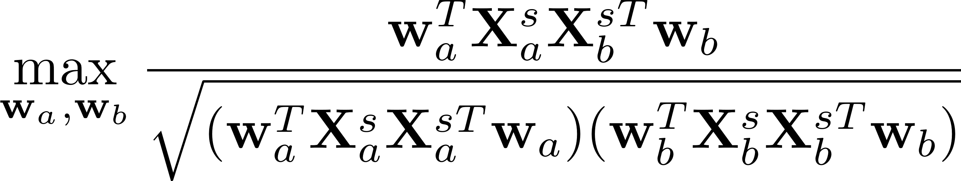
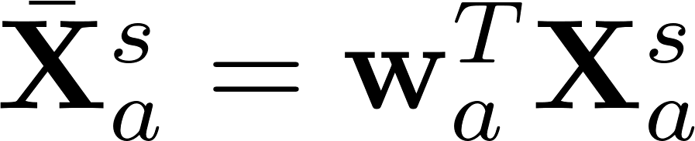
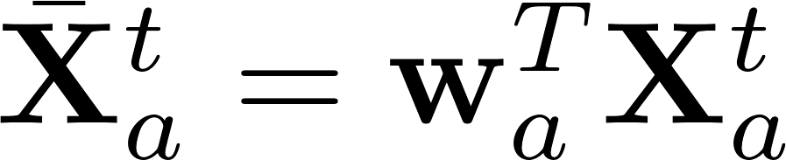
Canonical Correlation Analysis (CCA)
Training feature:
Testing feature:

Slide 11
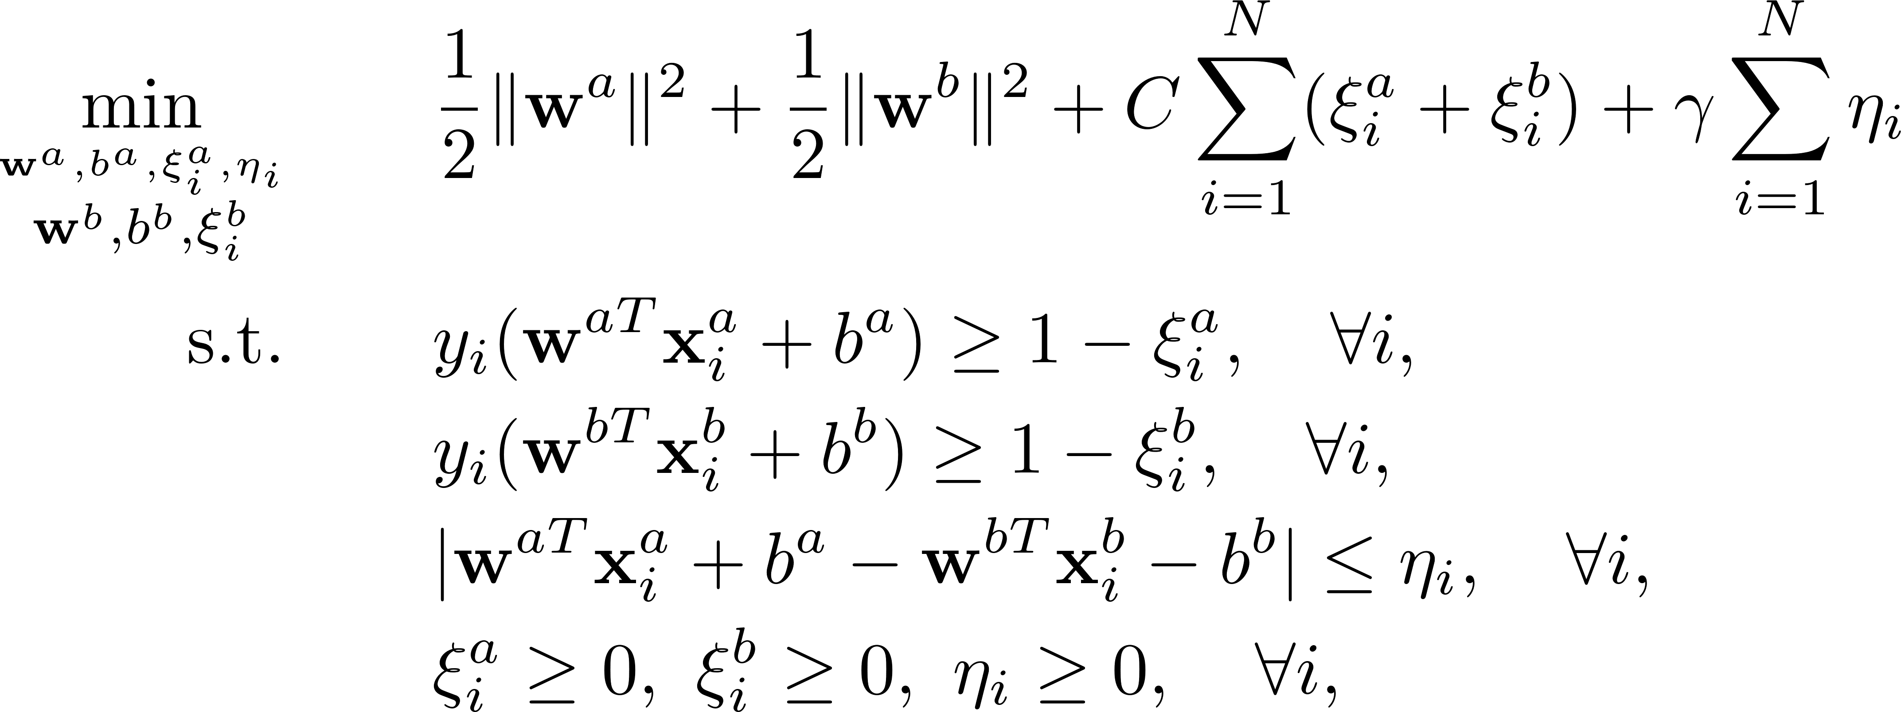
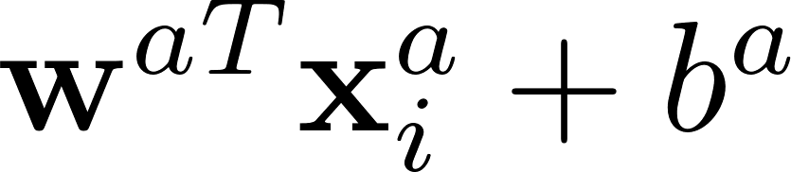
SVM-2K
Testing stage:

Slide 12
Learning using Privileged Information (PI)
The same as multi-view learning, but not use PI for test images
Generate pseudo PI for test images
Use PI to control the training process

Slide 13
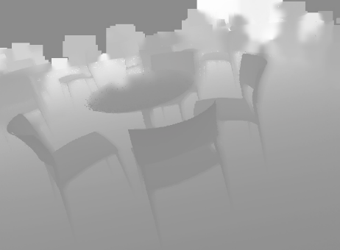
Generate Pseudo Privileged Information
Training:
visual feature
depth feature
Testing:
visual feature
depth feature

Slide 14
Generate Pseudo Privileged Information
Image to image translation: conditional GAN (pix2pix)

Slide 15

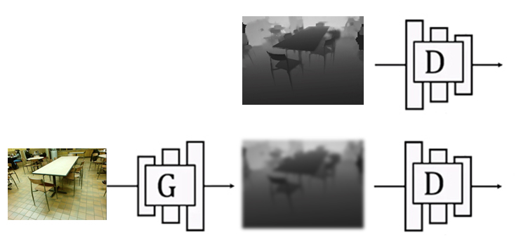


Conditional GAN (Question)
discriminator
real (0) or fake (1)?
generator
real (0) or fake (1)?

Slide 16
Conditional GAN (Answer)
discriminator
real (0) or fake (1)?
generator
real (0) or fake (1)?

Slide 17
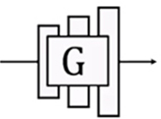
Generate Pseudo Privileged Information
Generate depth maps for test images using the learnt generator.

Slide 18
Generate Pseudo Privileged Information
Training:
visual feature
depth feature
Testing:
visual feature
depth feature

Slide 19
Generate Pseudo Privileged Information
depth feature
Hallucination network: learn the mapping from RGB image to depth feature

Slide 20
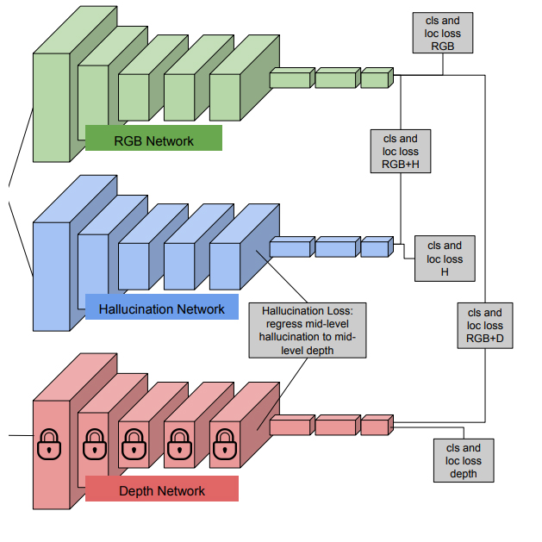


Hallucination network: training
RGB feature
RGB image
depth feature
depth image
depth feature
Hoffman, Judy, Saurabh Gupta, and Trevor Darrell. "Learning with side information through modality hallucination." CVPR, 2016.

Slide 21
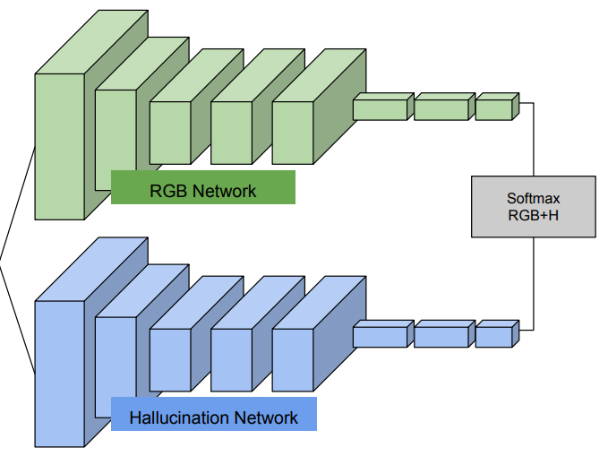

Hallucination network: testing
RGB feature
RGB image
depth feature
Hoffman, Judy, Saurabh Gupta, and Trevor Darrell. "Learning with side information through modality hallucination." CVPR, 2016.

Slide 22
Learning using Privileged Information (PI)
The same as multi-view learning, but not use PI for test images
Generate pseudo PI for test images
Use PI to control the training process

Slide 23
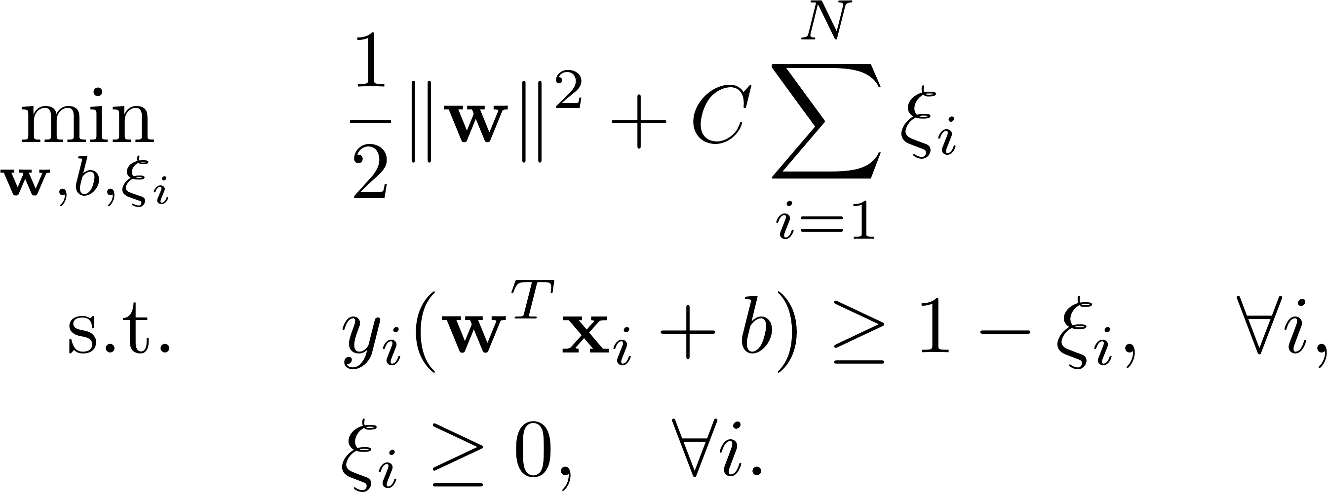
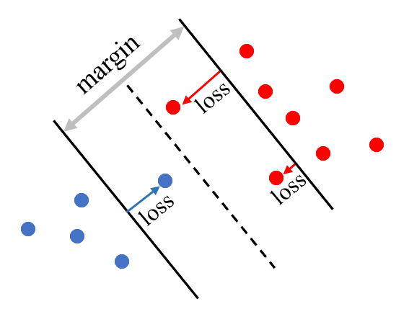
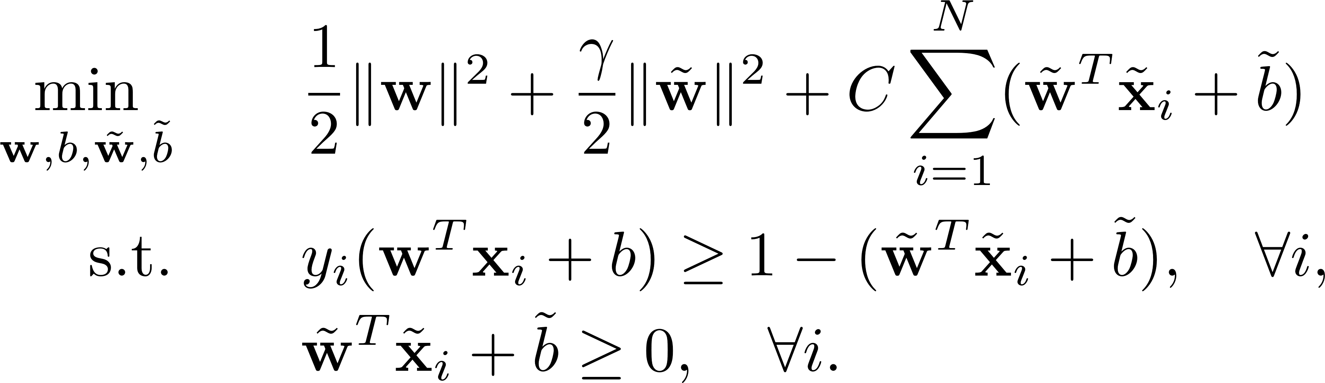
SVM+
slack variable
positive samples
negative samples
slack function

Slide 24
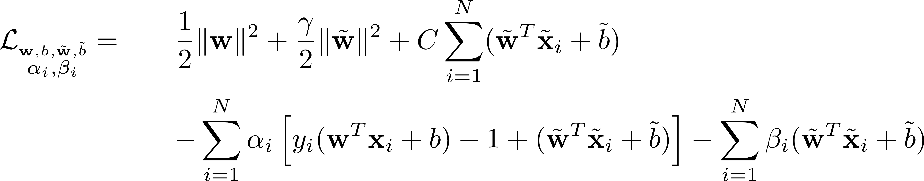
SVM+
Primal form:
Lagrangian form:

Slide 25
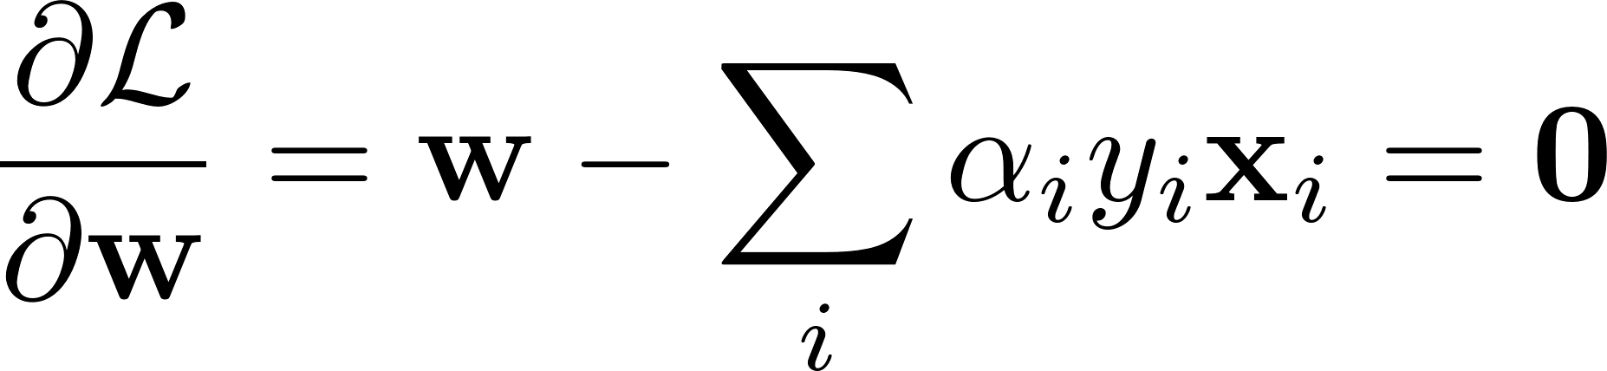
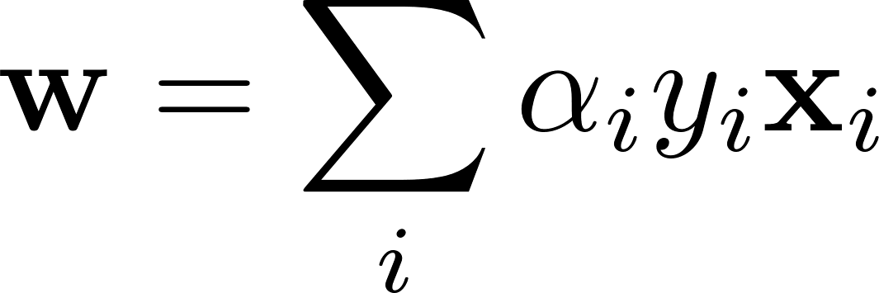
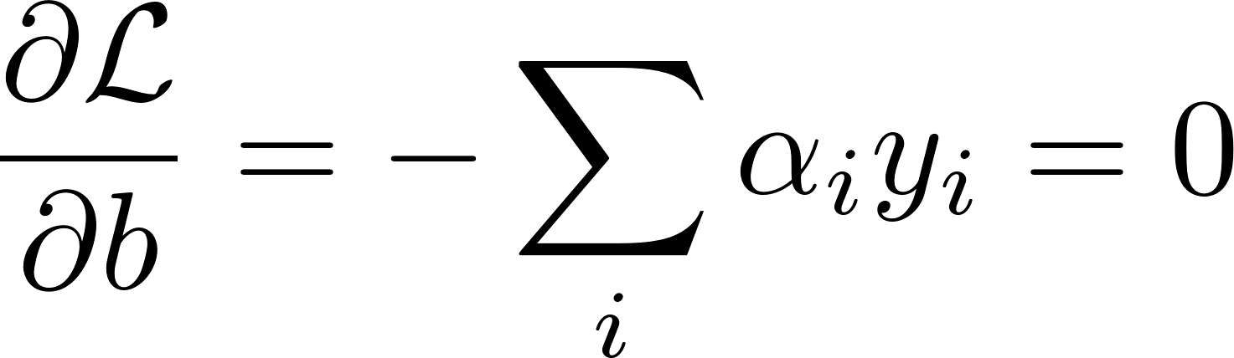
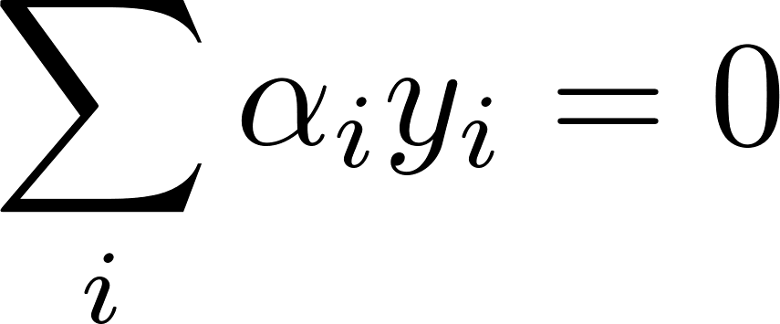
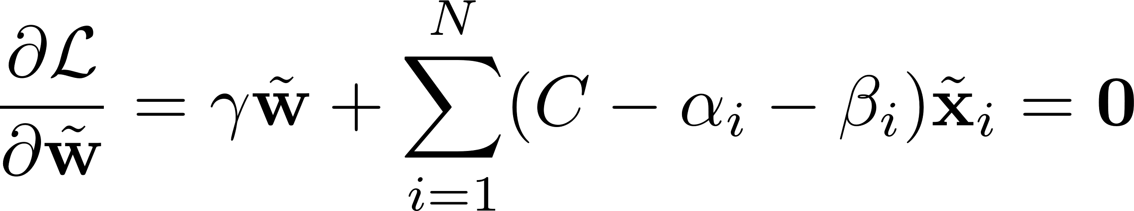
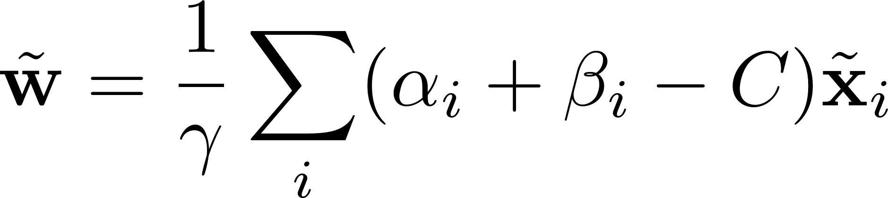
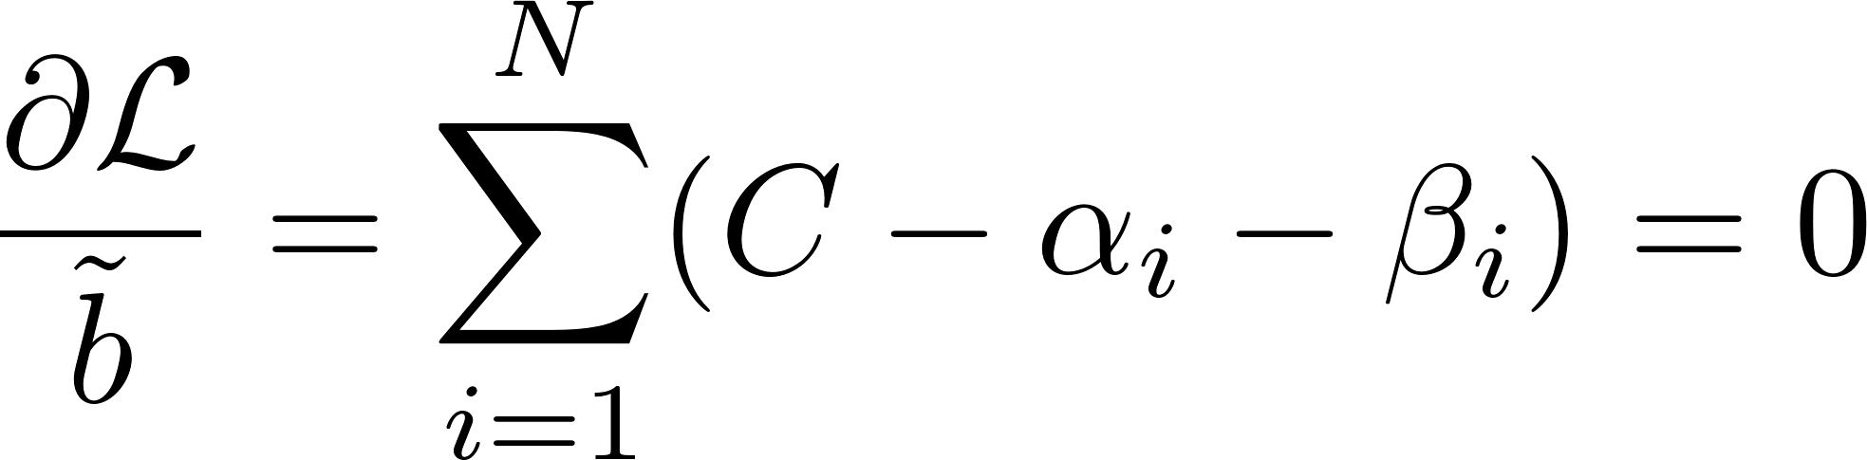
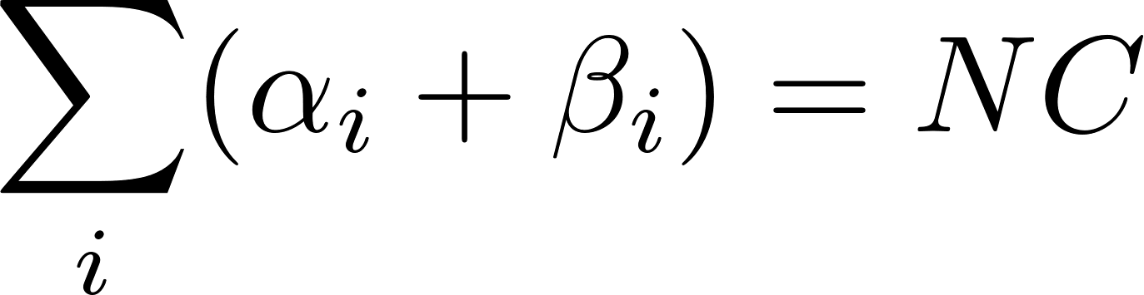
SVM+

Slide 26
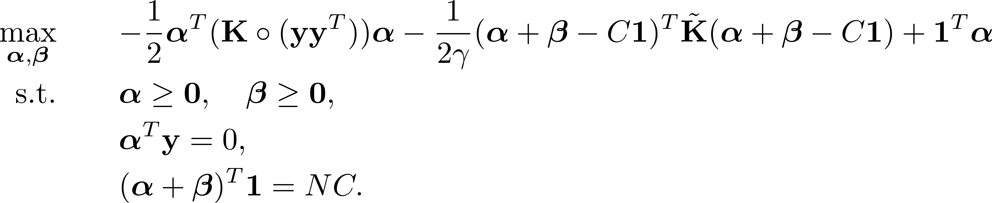
SVM+
Dual form:
Dual form can be solved using Quadratic Programming (QP).

Slide 27
What is left?
Single-View Learning:
Multi-View Learning:
Training feature
Training feature
….
Testing feature
….
Testing feature
?
Learning using Privileged Information:
Training feature
….
Training feature
….
Testing feature
Testing feature

Slide 28
What is left?
?
Training feature
….
Testing feature

Slide 29
If unlabeled test images are available in the training stage
Training:
visual feature
Testing:
visual feature
depth feature

Slide 30
If unlabeled test images are available in the training stage
Training:
visual feature
Testing:
visual feature
depth feature

Slide 31
If unlabeled test images are available in the training stage
Training:
visual feature
depth feature
Testing:
visual feature
depth feature

Slide 32
If unlabeled test images are available in the training stage
Training:
visual feature
Testing:
visual feature
depth feature

Slide 33
If unlabeled test images are available in the training stage
Training:
visual feature
depth feature
Testing:
visual feature
depth feature

Slide 34




If unlabeled test images are available in the training stage
visual feature
Training:
visual feature
depth feature
Testing:
Use to learn a symmetric similarity matrix

Slide 35

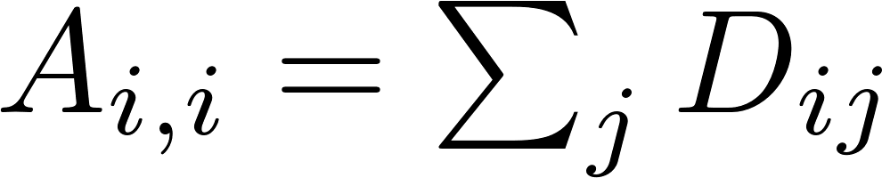


If unlabeled test images are available in the training stage
visual feature
Training:
visual feature
depth feature
Testing:
is a diagonal matrix with
Laplacian matrix

Slide 36
Thanks!

